Slide 1
World War II
War in the Pacific

Slide 2
Japanese continued advancing across the Pacific in 1942.
Japan advanced and conquered Thailand, Burma, the British colonies of Hong Kong and Singapore, and the U.S. territories of Guam and Wake Island.
Japanese then attacked U.S. controlled Philippines.
  American and Filipino forces under command of Douglas MacArthur
March 1942– Allied forces surrender Philippines to Japan.
  Japanese march more than 70,000 captured soldiers to prison camps.
  More than 600 Americans and 10,000 Filipinos died in the Bataan Death March.

Slide 3
Key Victories in the Pacific
Battle of Midway
Japanese planned surprise attack on Midway Islands.
American bombers destroy four carriers and severely weaken Japanese naval power.
Allied victory
Guadalcanal
Allies began recapturing Japanese territory.
August 1942– American Marines invade Guadalcanal.
Six months of intense fighting
February 1943– Allied victory

Slide 4
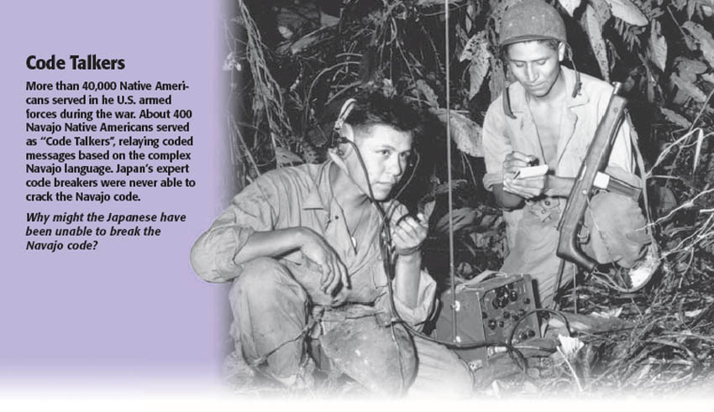

Slide 5
The Allies began battling toward Japan.
Allies go on offensive
  Develop island hopping strategy, where Allied forces took only the most strategically important islands.
  Win victories in Gilbert, Marshall, Mariana islands
  October 1944– General MacArthur leads mission to retake Philippines.
  Allies crush Japanese fleet. Allied forces drive out all Japanese forces by summer 1945.
Allied planes begin bombing targets in Japan.
  Japanese refused to surrender.

Slide 6
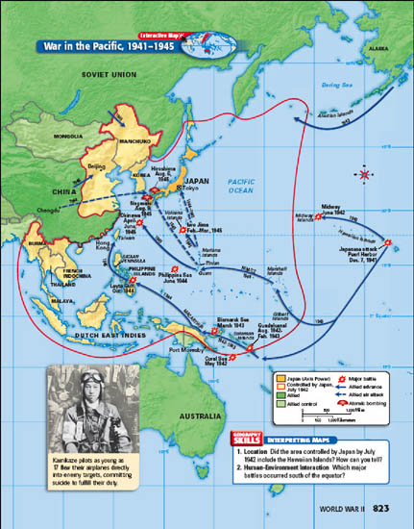

Slide 7
Final Battles
Iwo Jima
February 1945– U.S. Marines storm beaches of Iwo Jima
Month of bloody fighting
  Of 20,000 Japanese defenders, about a thousand were taken prisoner, the rest were killed or wounded in battle.
  Around 6,800 Americans killed
Okinawa
April 1945– U.S. forces attack Okinawa.
Fighting lasts three months
  Japanese planes use kamikaze tactic– purposely crashing piloted planes into enemy ships.
  Severe casualties
    Allies: 12,000 dead, 36,000 wounded
    Japan: 11,000 troops and 80,000 civilians dead

Slide 8
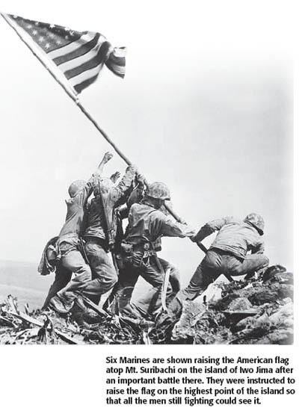

Slide 9
Victory in the Pacific came after the United States dropped atomic bombs on Japan.
Allied scientists developed the atomic bomb, a weapon that produces tremendous power by splitting atoms, in a secret program known as the Manhattan Project.
When Japanese leaders refused to surrender, President Truman ordered use of the bomb.
August 6, 1945– the B-29 bomber Enola Gay drops an atomic bomb on the city of Hiroshima.
  Explosion killed almost 80,000 people instantly.
  Thousands more died from burns and radiation poisoning.
Japanese leaders still refused to surrender.

Slide 10
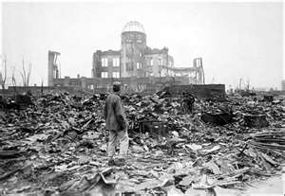
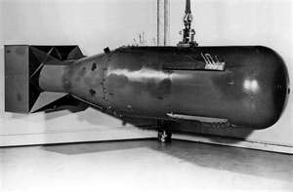

Slide 11
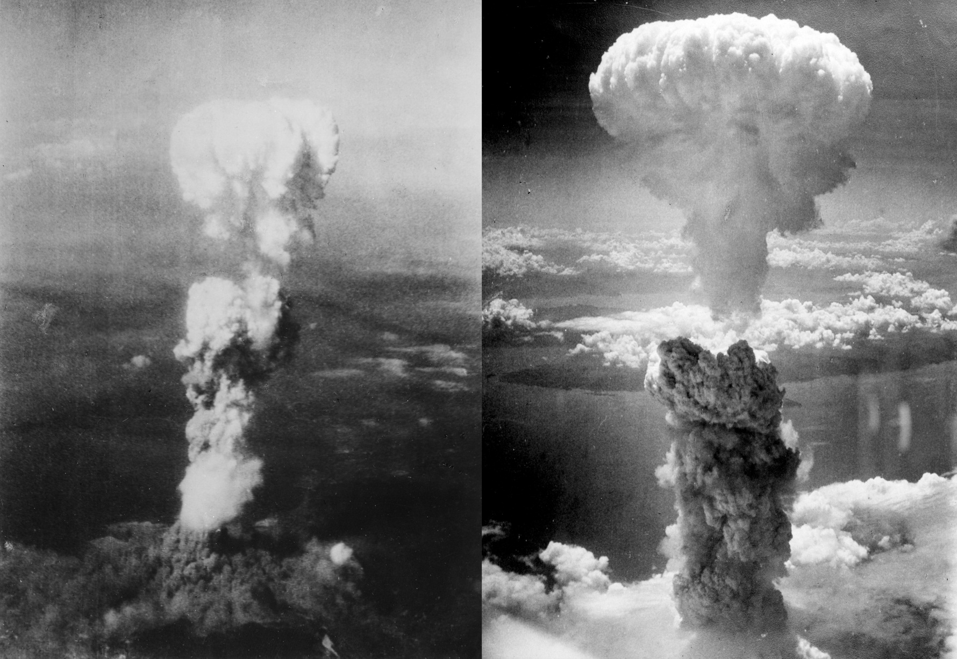

Slide 12
End of World War II
August 9, 1945– U.S. forces drop a second atomic bomb on city of Nagasaki.
  One-third of the city destroyed
  22,000 people killed instantly
August 15, 1945– Japanese announce their surrender thus ending World War II.
The war took a harsh toll.
  50 million people killed
  National economies in Europe and Asia devastated
  Millions of people left without food, water, or shelter

